Slide 1

Installing Motherboards and Connectors & Installing System Devices

Slide 2
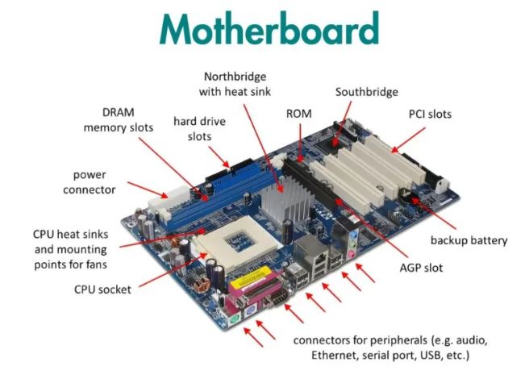
What is a Motherboard?
Definition: A motherboard is the main circuit board that connects all components of a computer system.
Functions:
  Distributes power to components
  Hosts CPU, RAM, and expansion slots
  Provides connectors for I/O devices
Form Factors:
  ATX: Full-sized board with many expansion slots
  Micro-ATX: Smaller with fewer slots
  Mini-ITX: Compact form, used in small builds

Slide 3
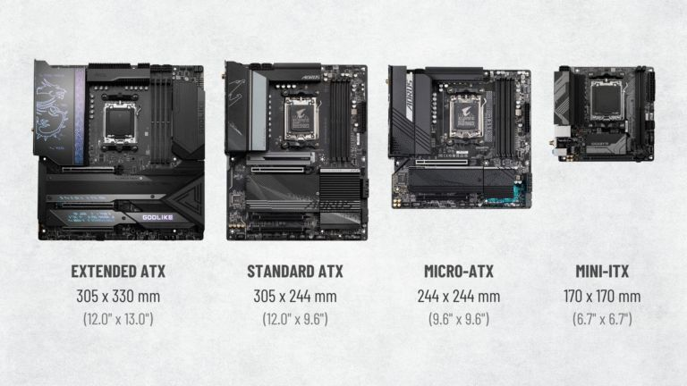

Slide 4

Key Components on a Motherboard
CPU Socket: Where the processor is installed (Intel LGA, AMD AM4, etc.)
RAM Slots: Usually 2-4 DIMM slots for system memory
Chipset: Controls communication between CPU, RAM, storage
Power Connectors:
24-pin ATX main power
4/8-pin CPU power
Expansion Slots:
PCIe x16 for GPUs
PCIe x1 for network, sound cards
Storage Connectors:
SATA for HDD/SSD
M.2 for NVMe SSDs

Slide 5
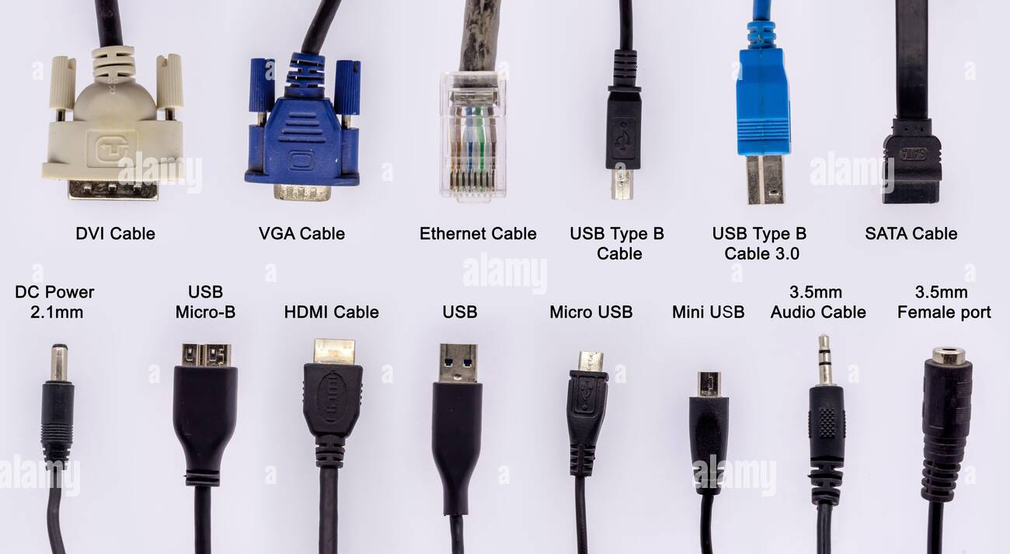
Common Cable Types in PCs
Power Cables:
24-pin ATX
4/8-pin EPS (CPU power)
Molex (legacy power for fans, older drives)
Data Cables:
SATA (modern storage)
IDE/PATA (legacy)
Front Panel Connectors:
USB 2.0 / 3.0 headers
HD Audio
Power switch, reset switch, HDD LED

Slide 6
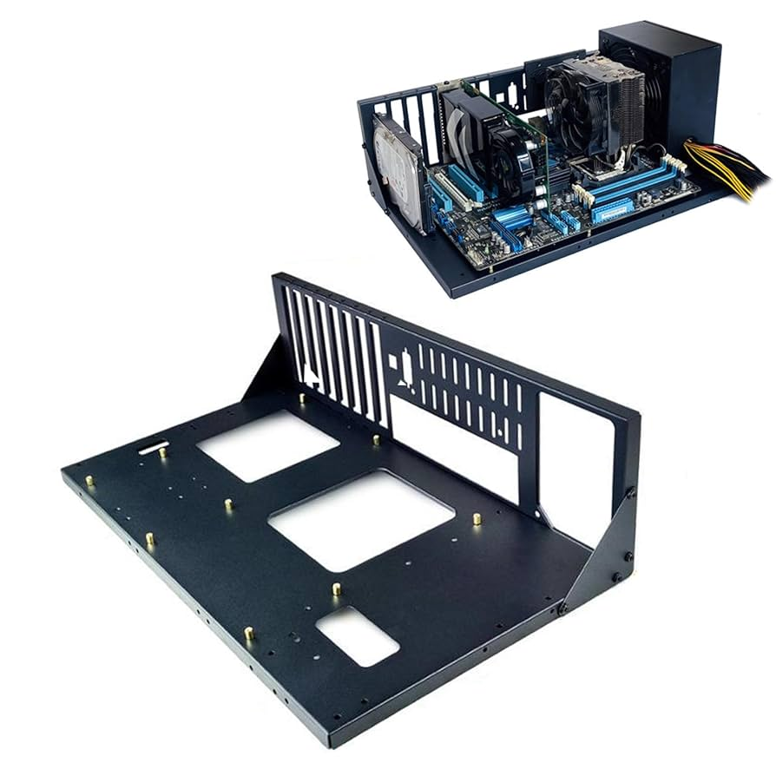
How to Install a Motherboard
Step 1: Prepare the case
  Install I/O shield on rear panel

Slide 7
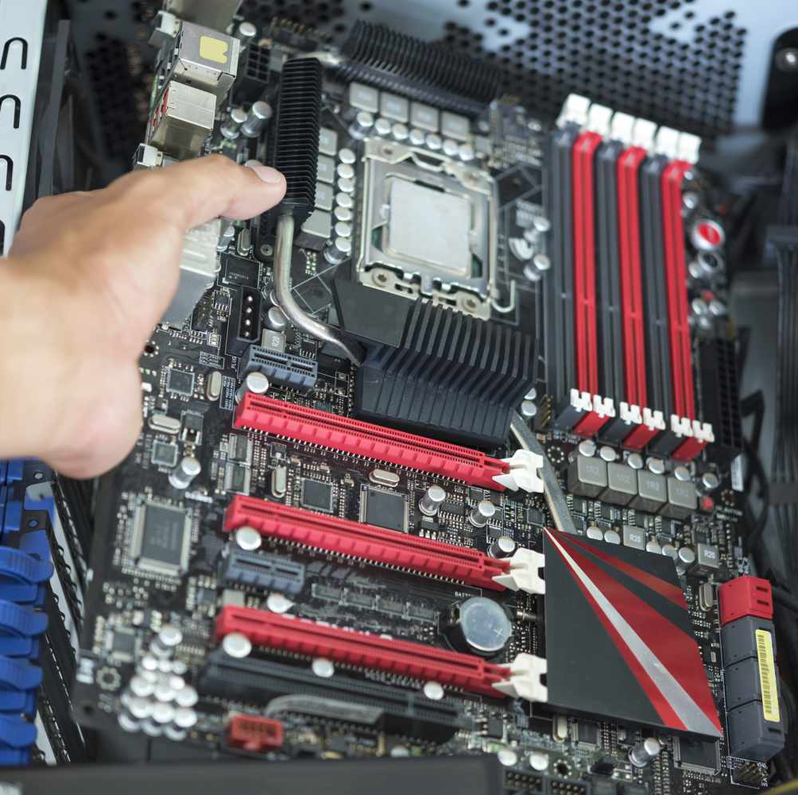
Step 2: Align motherboard with standoffs
Step 3: Secure with screws

Slide 8
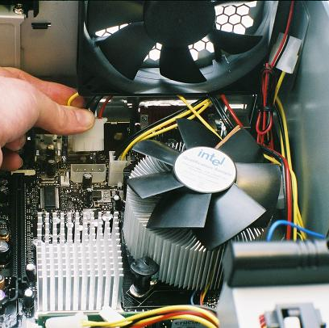
Step 4: Connect power cables

Slide 9
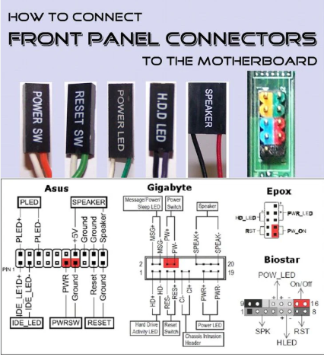
Step 5: Connect front panel headers

Slide 10
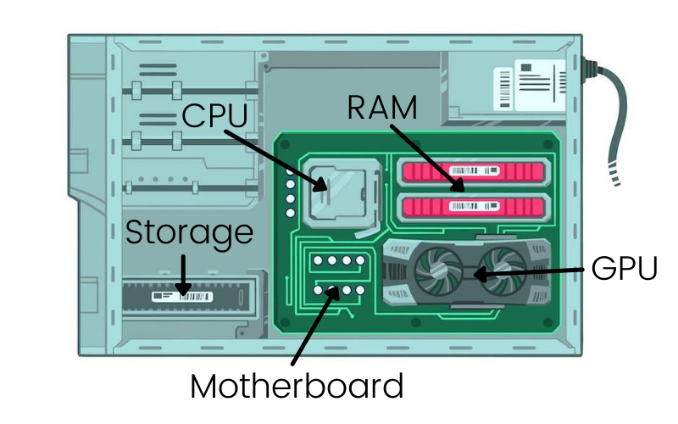
Step 6: Install CPU, RAM, and storage

Slide 11
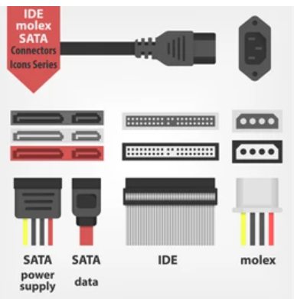
Older Cable Interfaces
IDE (PATA): 40-pin ribbon cable for older HDDs/ODDs
Floppy Drive Cables: 34-pin
Serial Ports: For older peripherals like modems
Parallel Ports: Printers and scanners
Compatibility Notes:
  Use adapter cards for modern motherboards
  Limited support in modern BIOS

Slide 12
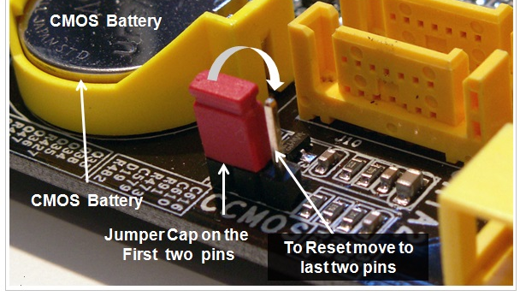
Maintaining BIOS Settings
CMOS Battery:
  Small CR2032 battery
  Retains BIOS settings when powered off
Jumpers:
  Clear CMOS jumper to reset BIOS
  Configured by shorting 2 pins with cap

Slide 13
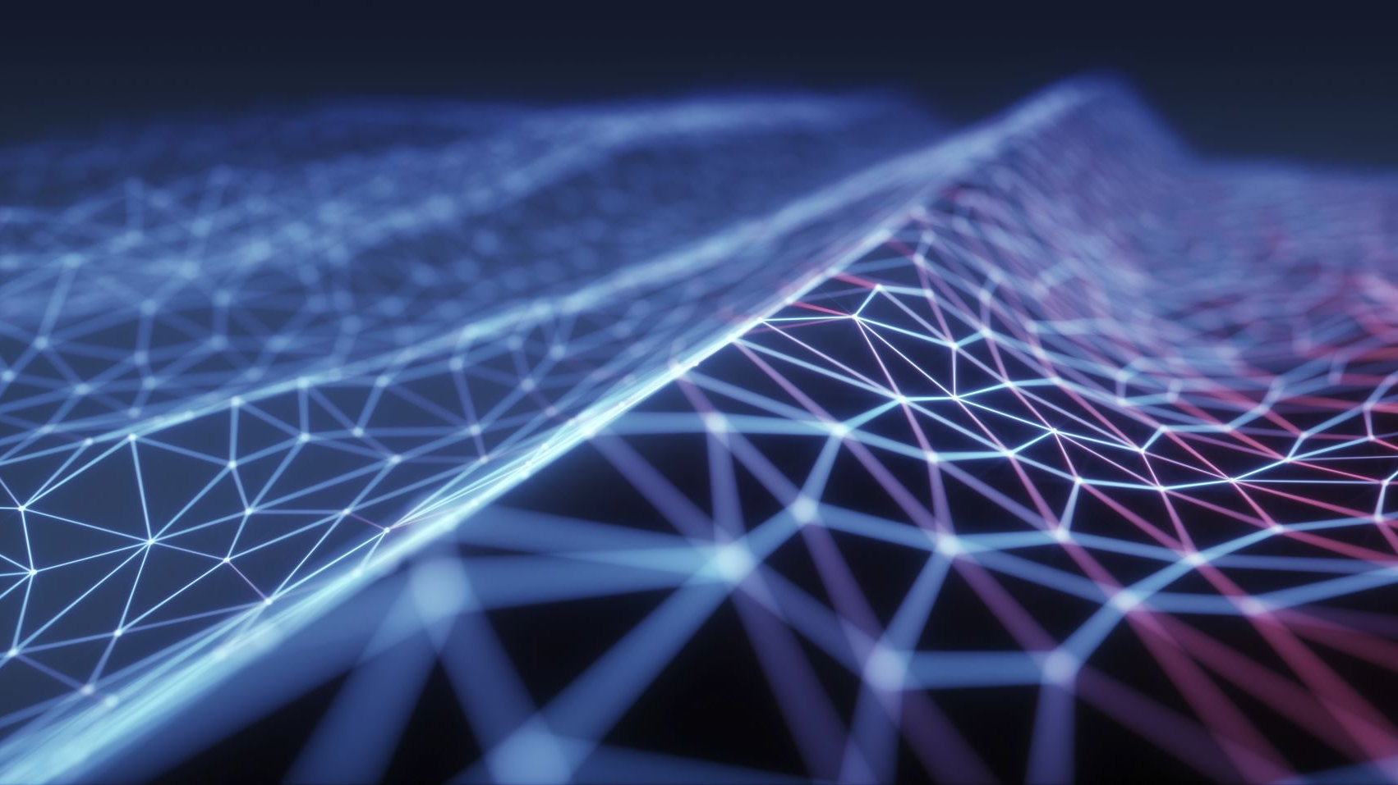
BIOS vs UEFI
BIOS (Basic Input Output System):
Text-based, keyboard-only
Limited to 2.2TB drives
UEFI (Unified Extensible Firmware Interface):
Graphical interface
Supports secure boot, network booting
Handles drives over 2.2TB
Key Settings:
Boot order
CPU/RAM diagnostics
Drive modes (AHCI/RAID)

Slide 14
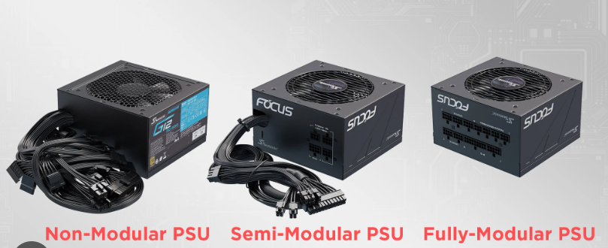
Understanding and Installing Power Supplies
Types of Power Supplies:
  Modular: Cables can be added/removed as needed
  Semi-Modular: Essential cables are fixed; others modular
  Non-Modular: All cables are permanently attached
Wattage Calculation:
  Use PSU calculators (like from Cooler Master or PCPartPicker)
  Consider GPU, CPU, and future expansion

Slide 15
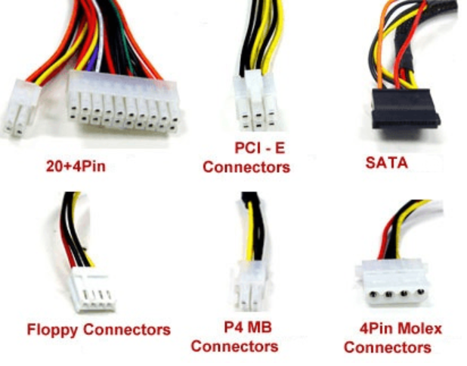
Power Supply Connectors
24-pin ATX Connector: Main power for motherboard
4/8-pin CPU Connector (EPS12V): Powers CPU
PCIe Connectors (6-pin/8-pin): Power for graphics cards
SATA Power Connectors: Modern drives (HDDs, SSDs)
Molex Connectors: Legacy devices (fans, older drives)

Slide 16
System Board Components
Bus architecture
Chipsets
Expansion slots
Memory slots and cache
Central processing units and processor sockets
Power connectors
Onboard non-volatile storage connectors (such as for hard drives)
Motherboard headers
BIOS/UEFI/firmware
CMOS and CMOS battery
Front-panel connectors and headers

Slide 17

Bus Architecture
A bus is a communication system that transfers data between components.
Types:
Data Bus: Transfers actual data
Address Bus: Carries memory address information
Control Bus: Manages control signals
Internal Buses: Connect CPU, RAM, and chipset
External Buses: Used for expansion cards and peripherals (e.g., PCIe)

Slide 18
Chipsets
Coordinates data flow between CPU, RAM, storage, and I/O.
Traditional Design:
Northbridge: Manages high-speed interfaces (CPU, RAM, GPU)
Southbridge: Handles slower devices (USB, SATA, audio)
Modern Chipsets:
Single chip architecture
Integrated memory and PCIe controllers in the CPU

Slide 19
Expansion Slots
Purpose: Allow additional cards to be installed (GPU, sound, NIC, etc.)
Common Types:
PCIe x16 – Graphics cards
PCIe x1 – NICs, USB cards
Legacy PCI – Rare in modern systems
PCIe Versions: 3.0, 4.0, 5.0 — higher bandwidth each gen

Slide 20
Memory Slots and Cache
Memory Slots:
Called DIMM (Dual In-line Memory Module) slots on desktops
SODIMM (Small Outline Dual In-line Memory Module) for laptops
Support dual/quad channel
Cache Memory:
L1/L2/L3: Located on CPU
Function: Stores frequently used instructions to reduce access time

Slide 21
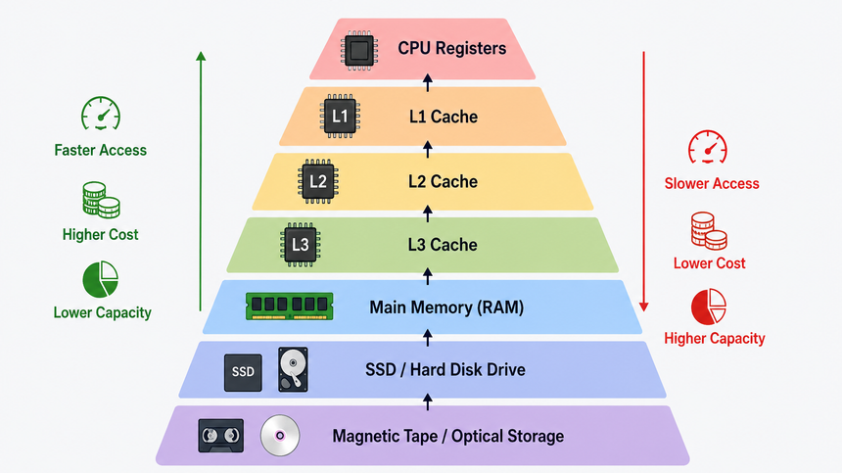

Slide 22
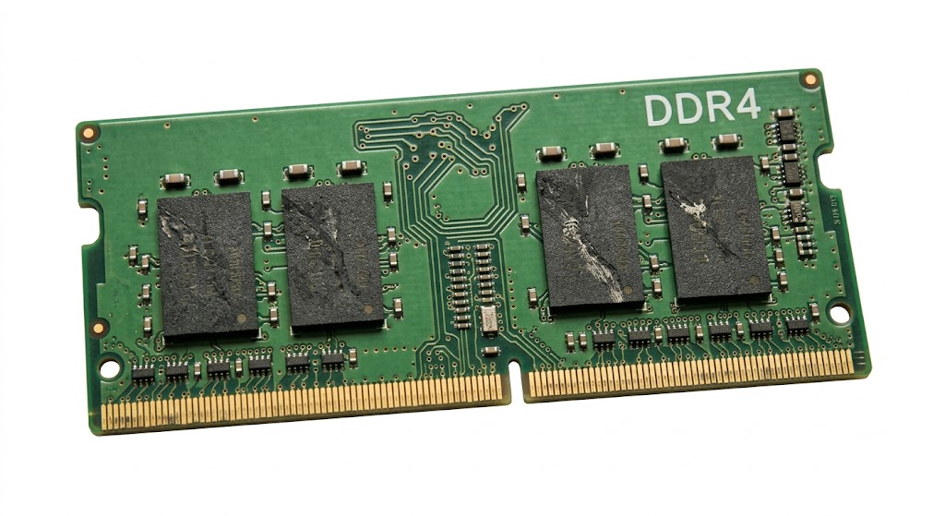
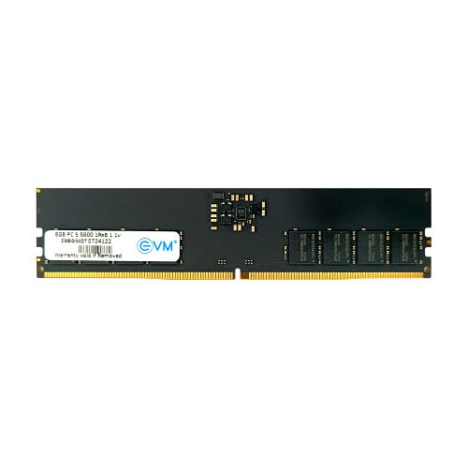
67.6 mm
260 Pins
133.35 mm
288 Pins

Slide 23
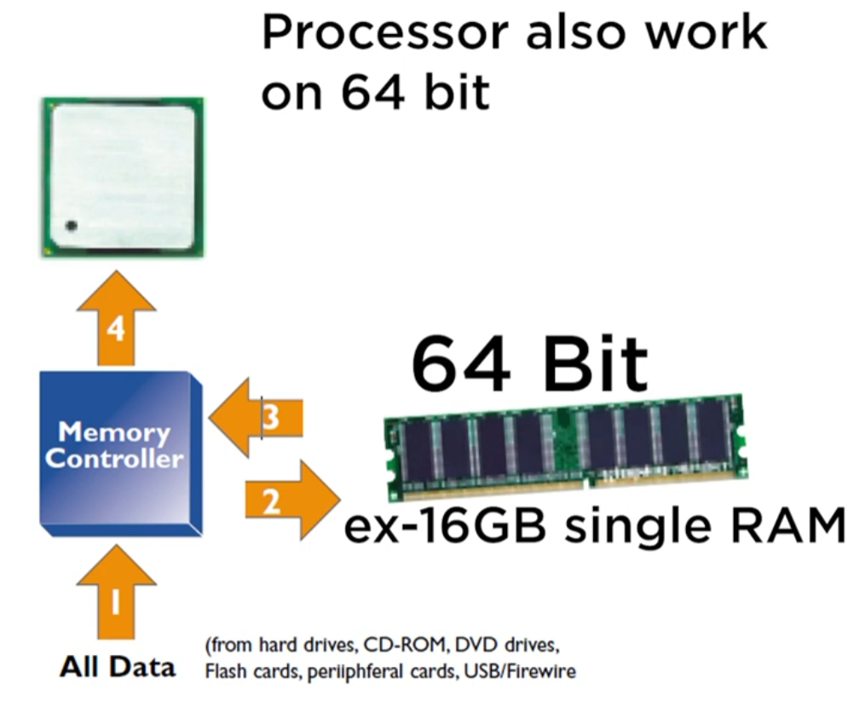
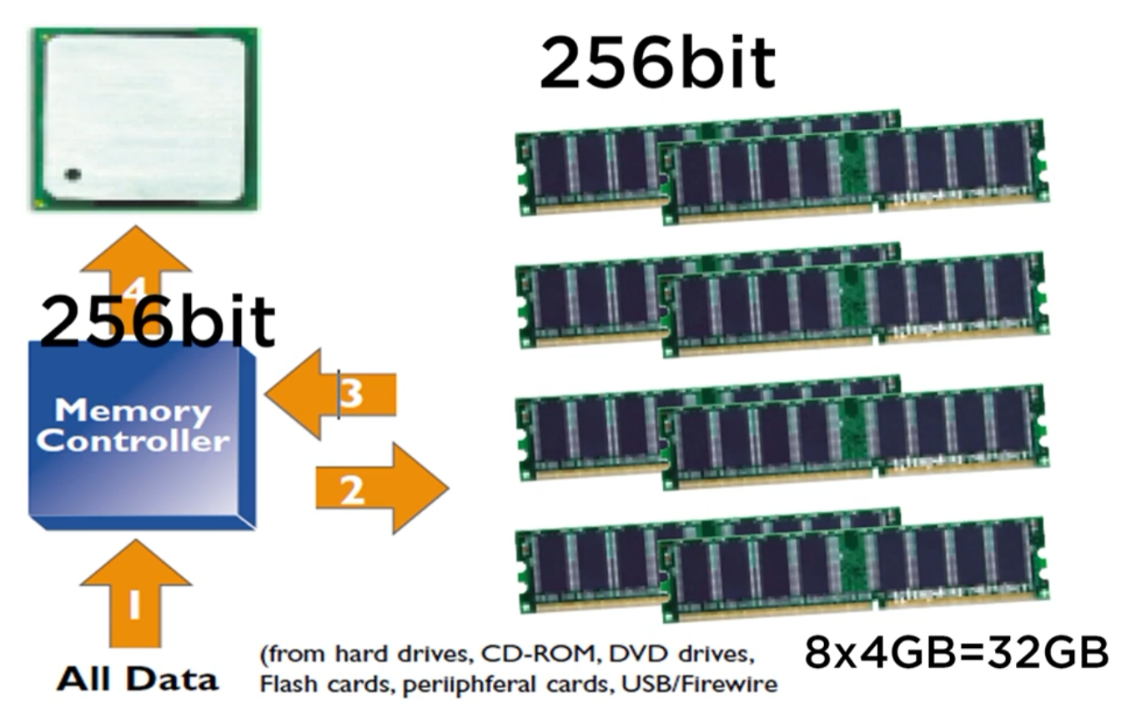
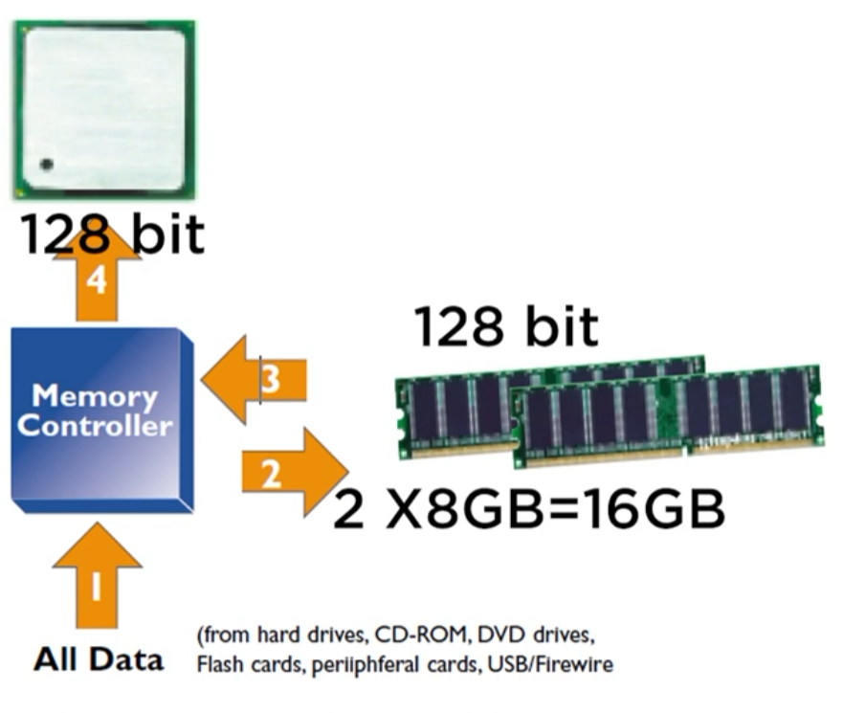

Slide 24
Memory Slots and Cache Contd...
Types of Cache Memory:
Level 1 Cache:
Fastest and smallest type of cache.
Located directly on the processor die.
Integrated into the CPU core itself—closest possible location for maximum speed.
Stores both instructions and data.
Typical size: 80 KB total (e.g., 32 KB for instructions, 48 KB for data per core).
Dedicated to each core — not shared

Slide 25
Memory Slots and Cache Contd...
Types of Cache Memory:
Level 2 Cache:
Larger but slower than L1 cache.
Still located on the CPU die in modern processors.
Typical size: 512 KB per core.
Usually dedicated per core, but in some architectures, it's shared between cores.
Acts as an intermediate layer between L1 and L3.

Slide 26
Memory Slots and Cache Contd...
Types of Cache Memory:
Level 3 Cache:
Largest and slowest among the cache hierarchy.
Size: typically 8–16 MB.
Shared among all cores of a processor.
Allows efficient communication and data exchange between CPU cores.

Slide 27
Memory Slots and Cache Contd...
Type | Location | Size Range | Speed | Shared/Dedicated
L1 Cache | On processor die | ~80 KB | Fastest | Dedicated per core
L2 Cache | On processor die | ~512 KB | Very fast | Usually per core
L3 Cache | On processor die | 8–16 MB | Slower | Shared across all cores

Slide 28
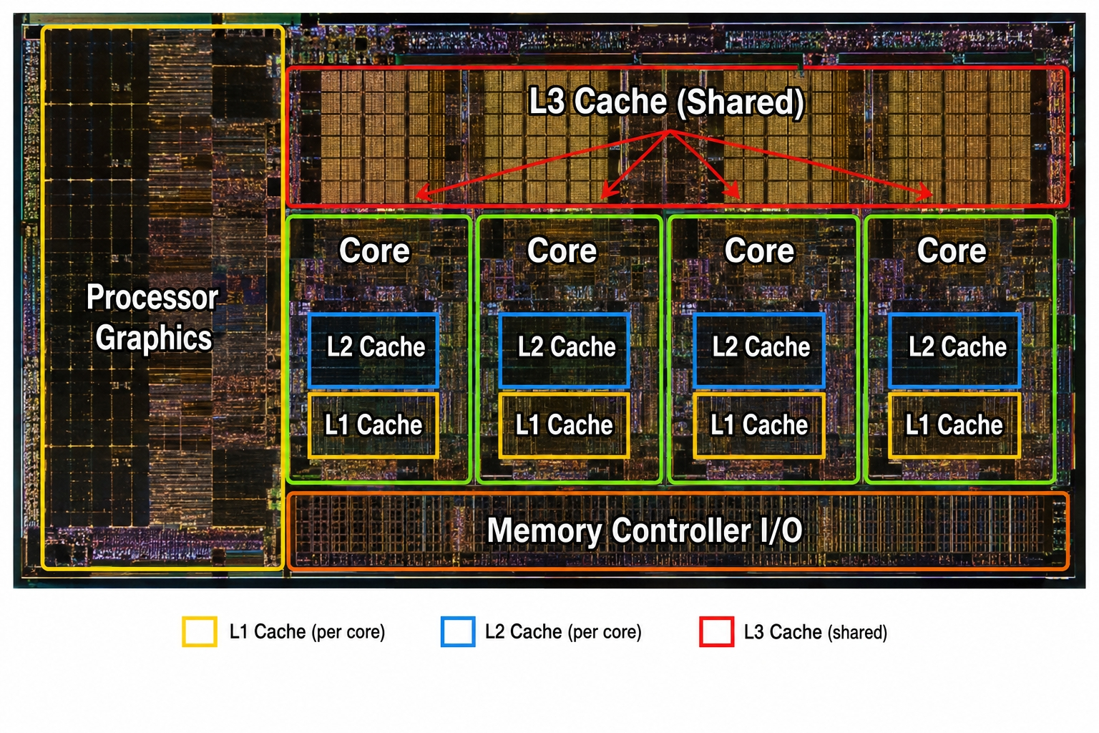

Slide 29
Central Processing Units (CPUs)
Executes system instructions
Installed into CPU socket on motherboard
Key specs: Clock speed, cores/threads, cache, TDP
Comes in Intel or AMD varieties

Slide 30
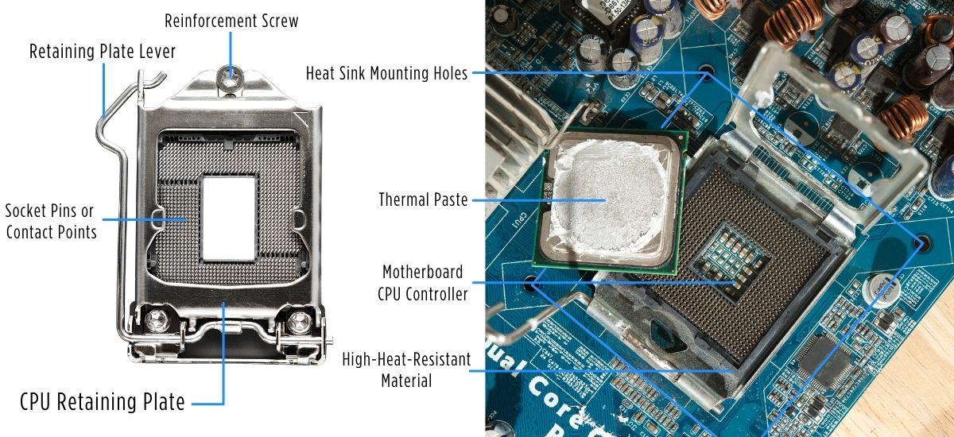
Processor Socket
LGA (Land Grid Array) – Intel CPUs
PGA (Pin Grid Array) – AMD CPUs
BGA (Ball Grid Array) – Non-removable, soldered
Socket must match CPU model
Motherboard BIOS may need updating for newer CPUs

Slide 31
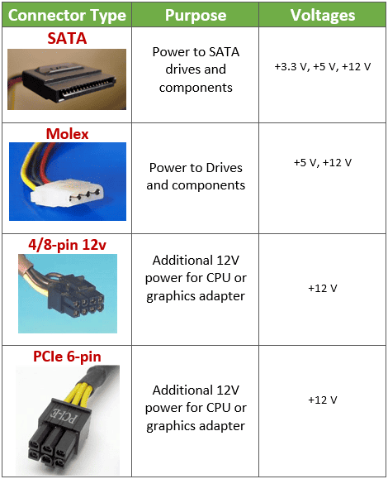
Power Connectors
Distribute power from PSU to motherboard and components
Main 24-pin ATX power connector
4/8-pin CPU power connector
SATA power connectors for drives
PCIe power connectors for graphics cards

Slide 32
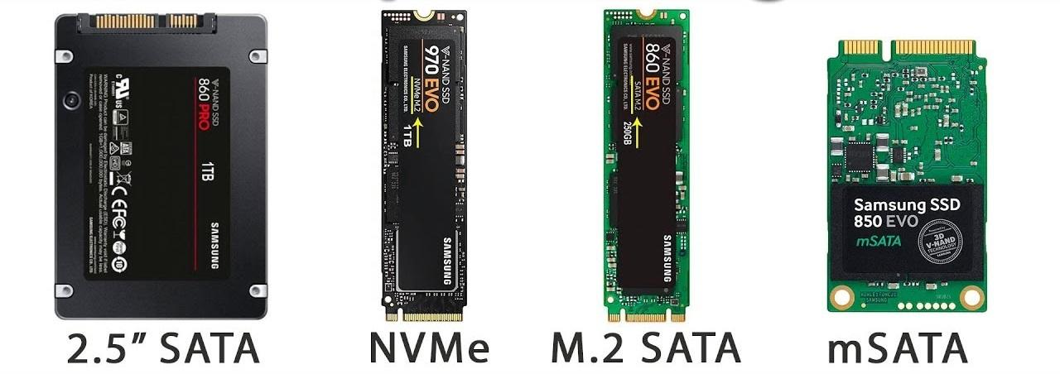
Onboard Non-Volatile Storage Connectors
Connectors for storage drives that retain data after power-off
SATA III – Standard for SSDs and HDDs
M.2 – For NVMe SSDs (faster, smaller)
U.2, mSATA – Older/enterprise connections
Connected directly to chipset or CPU (for NVMe)

Slide 33
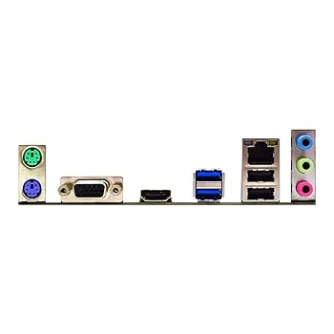
Motherboard Headers
Internal connectors used for:
USB headers (USB 2.0, 3.0, 3.2)
Audio headers (front panel audio)
Fan headers (CPU_FAN, SYS_FAN)
RGB/LED headers
Header types differ in pin count/layout

Slide 34
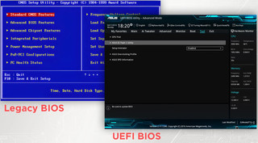
BIOS, UEFI
BIOS (Basic Input/Output System): Legacy firmware
UEFI (Unified Extensible Firmware Interface): Modern, GUI-based
Functions:
Hardware initialization
Boot sequence
Configuration utility
Stored in non-volatile flash memory

Slide 35
CMOS & CMOS Battery
CMOS (Complementary Metal-Oxide Semiconductor):
Stores BIOS/UEFI settings (time, date, boot order)
Battery (CR2032):
Powers CMOS chip when system is off
If dead, BIOS resets to defaults

Slide 36

Front-Panel Connectors and Headers
Connect case to motherboard:
Power switch
Reset switch
HDD activity LED
Power LED
Connected via small pin headers (e.g., F_PANEL)
Must follow manual for correct pin layout

Slide 37
Cooling Components and Installation
Types of Cooling Systems:
Air Cooling: Heatsinks with fans (common and budget-friendly)
Liquid Cooling: Closed-loop or custom (efficient, expensive)
Passive Cooling: No fans (low-power builds only)
Installing Cooling:
Apply thermal paste (pea or line method)
Mount CPU cooler onto socket
Attach and align case fans (intake/exhaust)

Slide 38
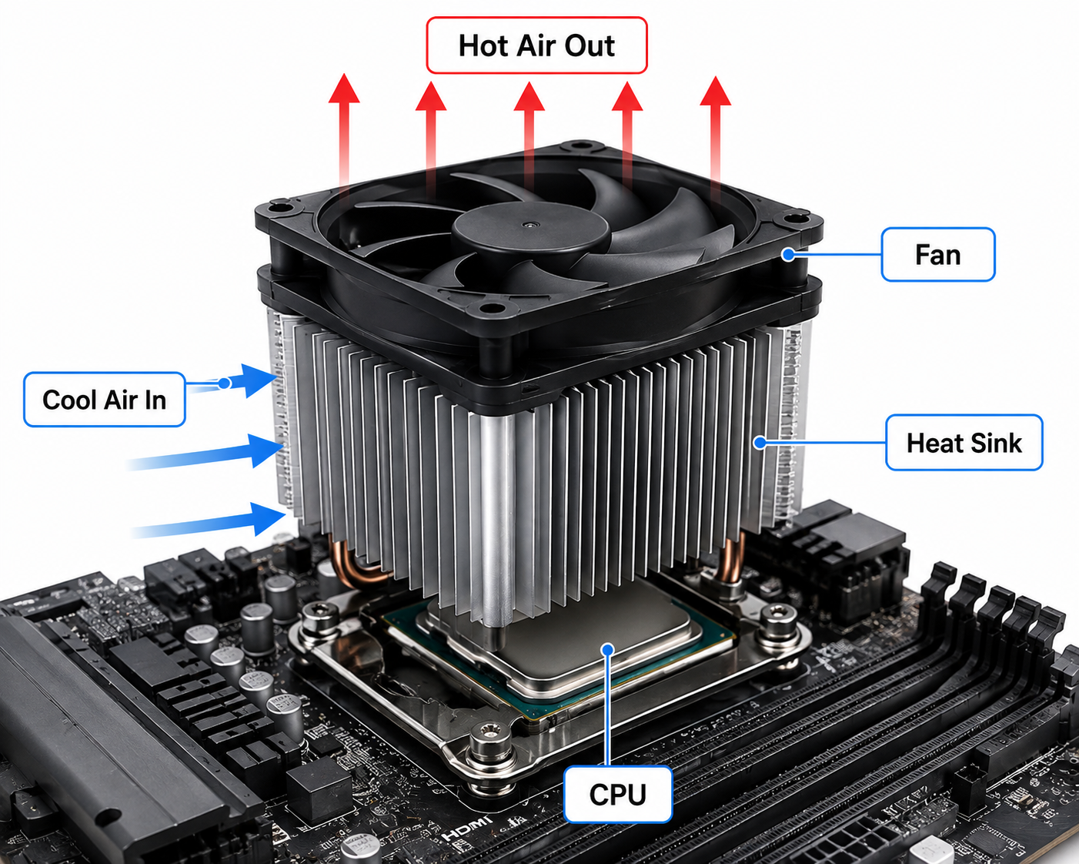
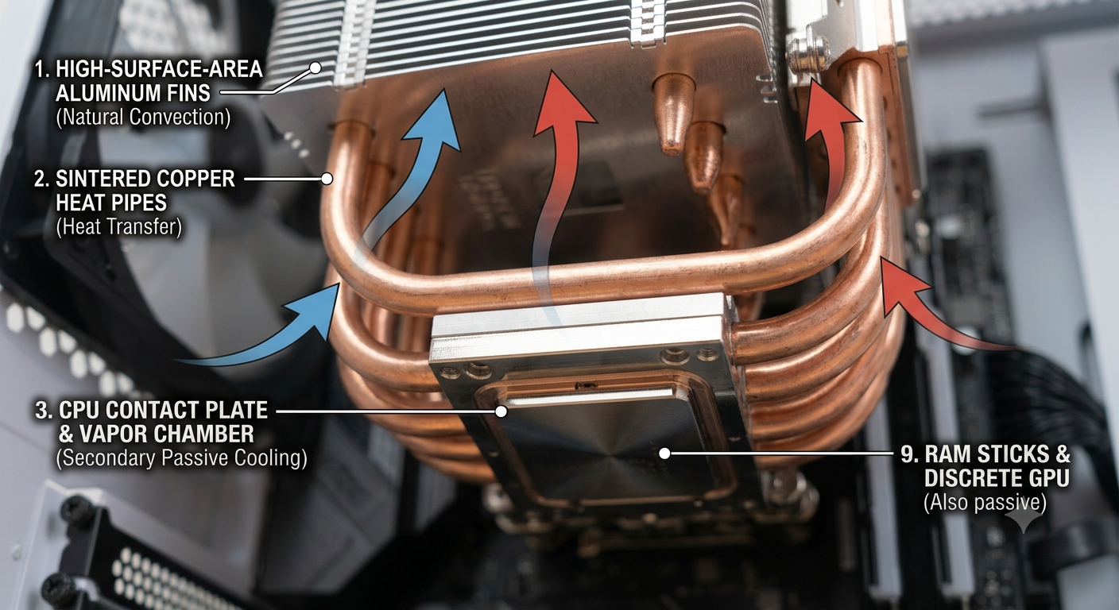

Slide 39
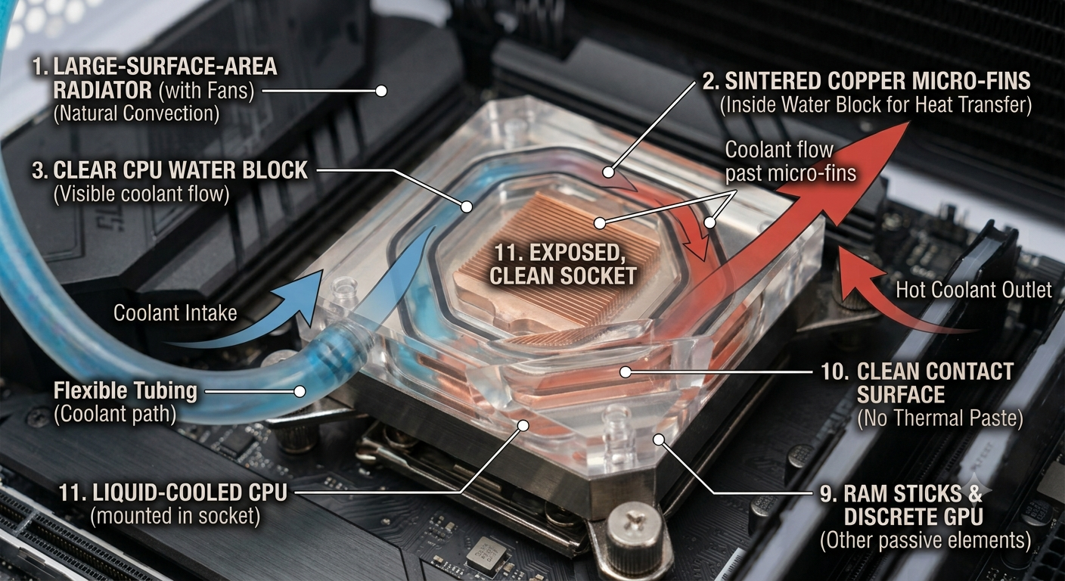

Slide 40
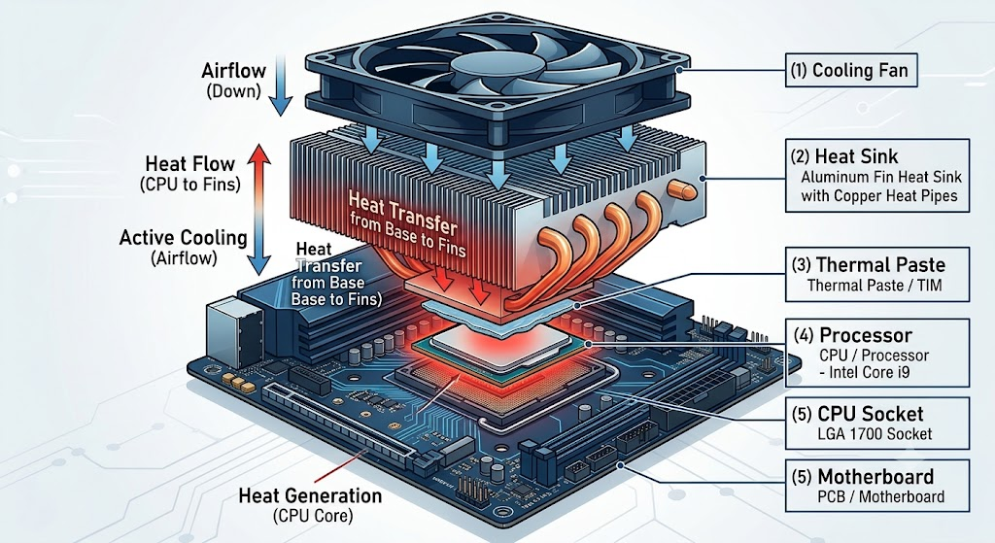

Slide 41
Connecting Storage Components
Drive Types:
HDD: High capacity, slower
SSD (SATA): Faster, common upgrade
NVMe (M.2): Fastest, uses PCIe lanes
Mounting Drives:
Use brackets, screws or trays
Secure properly in drive bays or M.2 slot
Cable Connections:
SATA Data + SATA Power
M.2/NVMe needs only screw and PCIe lane slot

Slide 42
Setting Up Storage in BIOS/OS
BIOS/UEFI Detection:
Confirm storage is detected in BIOS
Windows/Linux Setup:
Use Disk Management (Windows)
Use lsblk, fdisk, mkfs (Linux)
RAID (Redundant Array of Independent Disks):
RAID 0 (striping), RAID 1 (mirroring), RAID 5 (parity)
Requires multiple drives and RAID-capable board/controller

Slide 43
Understanding RAM Installation
RAM Types:
  DDR3 (older), DDR4 (current mainstream), DDR5 (newer, faster)
RAM Channels:
  Single, Dual, Quad channel setups for better performance
Installation Tips:
  Match RAM speed and size
  Insert in correct slots (check motherboard manual)
BIOS Check:
  Ensure full capacity detected
  Enable XMP Profile for correct speed

Slide 44
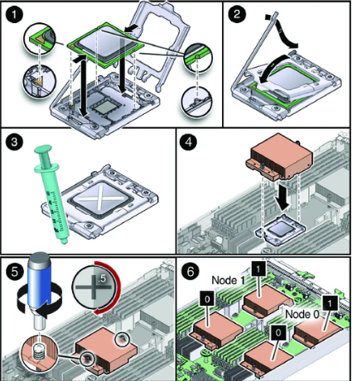
CPU Installation Guide
Intel vs AMD Sockets:
  Intel (LGA1700, LGA1200), AMD (AM4, AM5)
Installation Steps:
  Lift socket arm/cover
  Align notches and gently insert CPU
  Lock down with arm or retention mechanism
  Apply thermal paste and install cooler

Slide 45
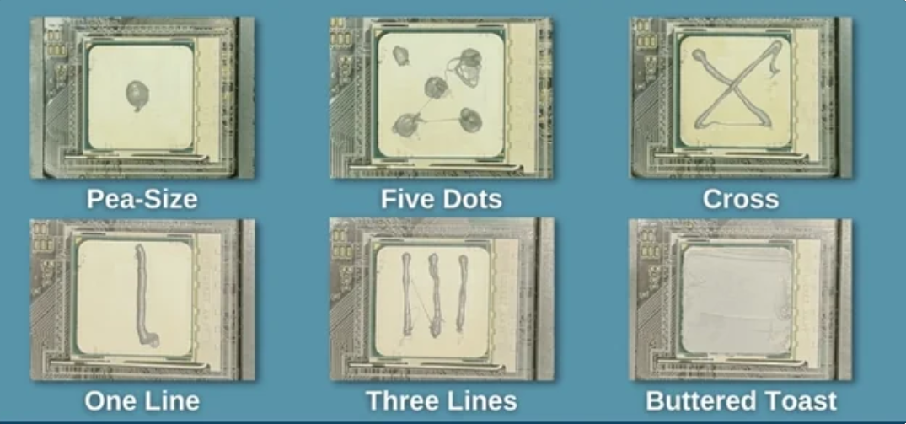
Managing System Thermals
Thermal Paste Application:
  Pea-sized dot or line in the center
  Avoid over-application
Airflow Planning:
  Front: Intake, Rear/Top: Exhaust
  Maintain positive/neutral pressure
Fan Placement Tips:
  Use dust filters, align airflow
  Connect fans to headers (CPU_FAN, SYS_FAN)

Slide 46
Final System Build Checklist
Cable Management:
Route cables behind motherboard tray
Use zip ties or Velcro straps
Screw Types:
Motherboard screws, M.2 screws, case screws
Post-Build Checks:
POST screen appears
Fans spinning, LEDs on
BIOS recognizes all components

